Slide 1
The Function Design Recipe
CS 5010 Program Design Paradigms “Bootcamp”
Lesson 1.1
© Mitchell Wand, 2012-2014
This work is licensed under a Creative Commons Attribution-NonCommercial 4.0 International License.
TexPoint fonts used in EMF.
Read the TexPoint manual before you delete this box.: AAA

Slide 2
Module 01
Data Representations
Design Strategies
Basics
Combine simpler functions
Generalization
Mixed Data
Over Constants
Use a template
Recursive Data
Over Expressions
Divide into Cases
Functional Data
Over Contexts
Call a more general function
Objects & Classes
Over Data Representations
Stateful Objects
Communicate via State
Over Method Implementations

Slide 3
Learning Objectives
By the time you complete this lesson, you should be able to:
list the 6 steps of the Function Design Recipe
briefly explain what each step is.
explain the difference between information and data, and explain the role of representation and interpretation.
Replace "Learning Objectives" by "Key Points for Lesson M.N", as we do in Module 10 et seq??

Slide 4
The function design recipe
The function design recipe is the most important thing in this course. It is the basis for everything we do.
It will give you a framework for attacking any programming problem, in any language. Indeed, students have reported that they have found it useful in other courses, and even in their everyday life.
With the recipe, you need never stare at an empty sheet of paper again.
Here it is:

Slide 5
The Function Design Recipe
The Function Design Recipe
1. Data Design
2. Contract and Purpose Statement
3. Examples and Tests
4. Design Strategy
5. Function Definition
6. Program Review
This is important. Write it down, in your own handwriting. Keep it with you at all times. Put it on your mirror. Put it under your pillow. I’m not kidding!
Notes:
Here is the function design recipe.

Slide 6
Brief Explanation of the Recipe
Data Design: what kind of data does your system deal with, and what does each possible value of the data mean?
Contract: what kinds of values does your function take as its arguments, and what kind of values does it return?
Purpose Statement: given a particular input, which value should the function return?
Examples/Tests: what is a typical call of your function? How can somebody tell whether your function is returning a correct value?
Strategy: how does your function compute the desired value? Describe the way it works in a tweet.
Function Definition: the code of the function.
Program Review: now that you have a working function, how can it or its explanation be improved to make it clearer to a reader?

Slide 7
A Function Designed According to the Recipe
Information Analysis and Data Design (none in this example)
;; DATA DEFINITIONS: none
;; f2c: Real -> Real
;; GIVEN: a temperature in Fahrenheit,
;; RETURNS: the equivalent in Celsius.
;; EXAMPLES:
;; (f2c 32) = 0
;; (f2c 212) = 100
;; DESIGN STRATEGY: Combine simpler functions
(define (f2c x)
(+ (* 5/9 x) -160/9))
;; TESTS
(begin-for-test
(check-equal? (f2c 32) 0 "32 Fahrenheit should be 0 Celsius")
(check-equal? (f2c 212) 100 "212 Fahrenheit should be 100 Celsius"))
Contract (or Signature)
Purpose Statement
Examples
Design Strategy
Function Definition
Tests

Slide 8
The recipe is a recipe
It’s not just a list of components
It tells you the order in which you should do them.
Each step depends on the preceding ones.
If you do them out of order, you will get in trouble (trust me!)
In the rest of this lesson, we will discuss each step in turn, illustrating them using our f2c example.

Slide 9
Step 1: Information Analysis and Data Design
Information is what lives in the real world. To do this step, you need to do 3 things:
You need to decide what part of that information needs to be represented as data.
You need to decide how that information will be represented as data
You need to document how to interpret the data as information
Notes:
The first step is Information Analysis and Data Design.
To understand this step, we need to understand the difference between information and data. In this course, we use the word “information” to mean information about the real world. We use the word “data” to mean the way that information is represented in my computer program.
For example, right now I am wearing a red shirt. That’s information. I can represent that information by a string, say “rouge”. That’s data. (I chose “rouge” rather than “red” because my customer is French!).
In any application, we need to decide what part of all the information in the world needs to be represented as data, and exactly how it will be represented.
And we need to document that representation so that others can understand our program (remember, programs are meant to be read by people!)

Slide 10
The relation between information and data
representation
Information
Data
interpretation
stuff in the real world
bits in a computer
Notes:
Information is represented as Data
Data is interpreted as Information

Slide 11
Information and Data: Example
representation
My shirt is red
c = "rouge"
interpretation
How do we know that these are connected?
Answer: we have to write down the interpretation.
Notes:
Information is represented as Data
Data is interpreted as Information

Slide 12
Information and Data: Example
representation
My shirt is red
c = "rouge"
interpretation
Interpretation:
c = the color of my shirt, as a string, in French
This is part of the program design process.
Notes:
Information is represented as Data
Data is interpreted as Information

Slide 13
Deliverables for Step 1 (Information Analysis and Data Design)
Constructor Template
a recipe for how to build values of this data type
Observer Template
a template for functions that look at values of this type
Interpretation
what each value of the type represents
Struct Definitions
declarations of new data structures, if any
Examples
see Slogan #2 (Lesson 0.2)

Slide 14
That first step was a big one!
... but important: the vast majority of errors in student programs can be traced back to errors in step 1!

Slide 15
Step 2: Contract and Purpose Statement
Contract: specifies the kind of input data and the kind of output data
Purpose Statement: A set of short noun phrases describing what the function is supposed to return. These are typically phrased in terms of information, not data.
The generally take the form GIVEN/RETURNS, where each of these keywords is followed by a short noun phrase.
When possible, they are phrased in terms of information, not data.

Slide 16
Examples of Contract and Purpose Statements
data
f2c : Real -> Real
GIVEN: a temperature in Fahrenheit
RETURNS: the corresponding temperature in Celsius
add-cat-to-scene : Cat Scene -> Scene
GIVEN: a Cat c and a Scene s
RETURNS: A Scene like s, except that the Cat c has been painted on it.
information

Slide 17
A Cat is not a cat
We wrote:
add-cat-to-scene : Cat Scene -> Scene
GIVEN: a Cat c and a Scene s
RETURNS: A Scene like s, except that the Cat c has been painted on it.
but of course there are no cats in our computer. What this means is:
c is the representation of some cat
s is the representation of some scene
the function returns a representation of a scene like the one s represents, except the new scene contains an image of the cat.

Slide 18
Step 3: Examples
Some sample arguments and results, to make clear what is intended.
(f2c 32) = 0
(f2c 212) = 100

Slide 19
Tests
We will use the rackunit testing framework. Your tests will live in the file with your code, so they will be run every time you load your file. That way if you inadvertently break something, you’ll find out about it quickly. More on this later.
(check-equal? (f2c 32) 0
"32 Fahrenheit should be 0 Celsius")
(check-equal? (f2c 212) 100
"212 Fahrenheit should be 100 Celsius")

Slide 20
Step 4: Design Strategy
A short description of how to get from the purpose statement to the function definition
We will have a menu of strategies.
We'll cover this in more detail in Module 2
Here is our starting list of strategies:
Design Strategies
1. Combine simpler functions
2. Use template for <data def>
3. Divide into cases on <condition>
There will be more…

Slide 21
Design Strategy for f2c
For f2c, the strategy we will use is “combine simpler functions”
this is, we'll just assemble our function from functions we already have on hand

Slide 22
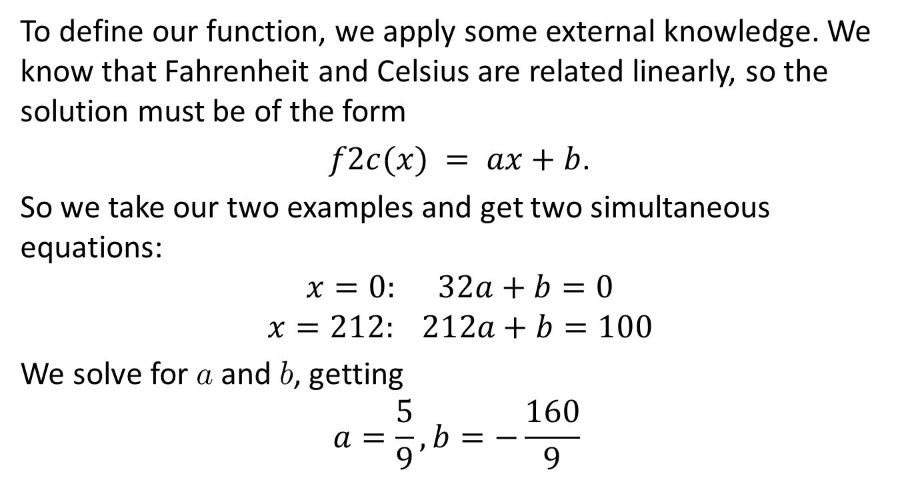
Step 5: Function Definition
To define our function, we apply some external knowledge. We know that Fahrenheit and Celsius are related linearly, so the solution must be of the form
$f2c(x) = ax+b$.
So we take our two examples and get two simultaneous equations:
$$x=0: 32a+b=0$$
$$x=212: 212a+b=100$$
We solve for a and b, getting
$$a=\frac{5}{9},b=−\frac{160}{9}$$

Slide 23
Function Definition
Now we can write the code.
Our code is just a transcription of the formula into Racket, using the fact that Racket has rational numbers.
(define (f2c x)
(+ (* 5/9 x) -160/9))

Slide 24
Step 6: Program Review
Did the tests pass?
Are the contracts accurate?
Are the purpose statements accurate?
Can the code be improved?

Slide 25
Summary
In this lesson, we have learned the steps of the Function Design Recipe.
6 steps
Gives a plan for attacking any programming problem
The single most important thing in this course!!

Slide 26
Next Steps
Review 01-1-f2c.rkt in the Examples folder.
Download and run it. Make some changes. What happens when you change the file?
If you have questions about this lesson, post them on Piazza.
Go on to the next lesson.

